Slide 1
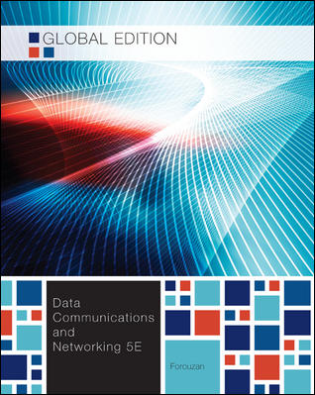
Chapter 8
Switching

Slide 2
Chapter 8: Outline
8.1 INTRODUCTION
8.2 CIRCUIT-SWITCHED NETWORK
8.3 PACKET-SWITCHING
8.4 STRUCTURE OF A SWITCH

Slide 3
Chapter 8: Objective
The first section introduces switching. It mentions three methods of switching: circuit switching, packet switching, and message switching. The section then defines the switching methods that can occur in some layers of the Internet model.
The second section discusses circuit-switched networks. It first defines three phases in these types of networks. It then describes the efficiency and delay of these networks.
The third section briefly discusses packet-switched networks. It first describes datagram networks. The section then describes virtual circuit networks.
The last section discusses the structure of a switch. It first describes the structure of a circuit switch. It then explains the structure of a packet switch.

Slide 4
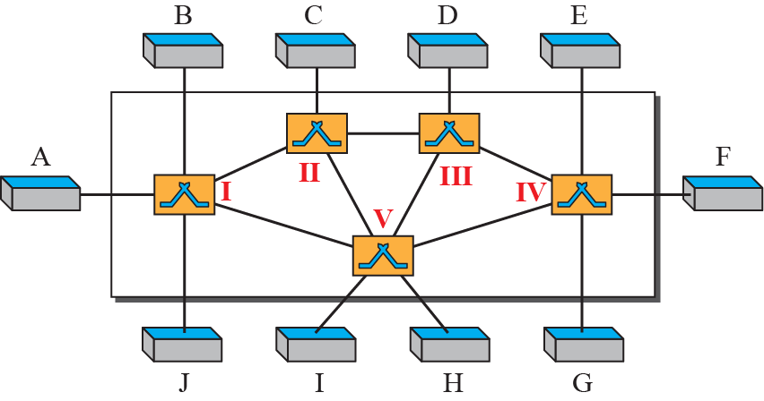
8.1 Introduction
A network is a set of connected devices.
  Whenever we have multiple devices, we have the problem of how to connect them to make one-to-one communication possible.
  The solution is switching.

Slide 5
8.1 Introduction
Switched Network
  Switched network consists of a series of interlinked modes.
  Switches creates temporary connections between two or more devices linked to the switch.
Topics discussed in this section:
8.1.1 Three Methods of Switching
8.1.2 Switching and TCP/IP Layers

Slide 6
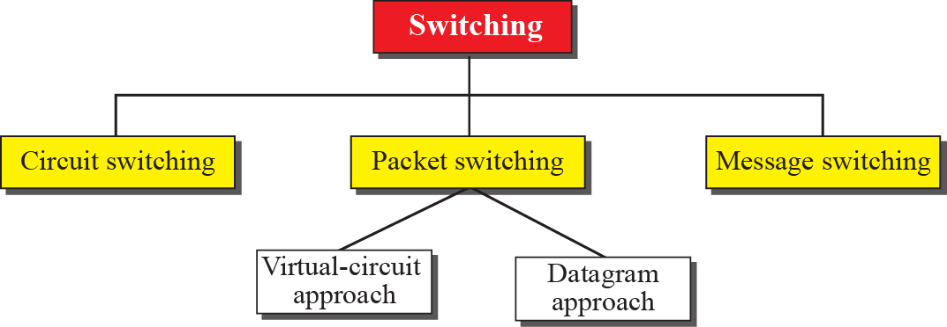
8.1.1 Three Methods of Switching
Three methods of switching
  The first two are commonly used today.
  The third has been phased out in general communications but still has applications.

Slide 7
8.1.2 Switching and TCP/IP Layers
Switching at Physical Layer
  Only circuit switching. No packets exchanged.
Switching at Data-link Layer
  Packet switching.
  Packets are called frames.
  Packets switching is done by virtual-circuit approach.
Switching at Network Layer
  Packet switching.
  A virtual-circuit or datagram approach can be used.
Switching at Application Layer
  Message switching.
  Conceptually e-mail is a kind of message switched communication.

Slide 8
8.2 Circuit Switched network
A circuit-switched network consists of a set of switches connected by physical links.
  A connection between two stations is a dedicated path made of one or more links.
  Each connection uses only one dedicated channel on each link.
  Each link is normally divided into n channels by using FDM or TDM.
Topics discussed in this section:
8.2.1 Three Phases
8.2.2 Efficiency
8.2.3 Delay

Slide 9
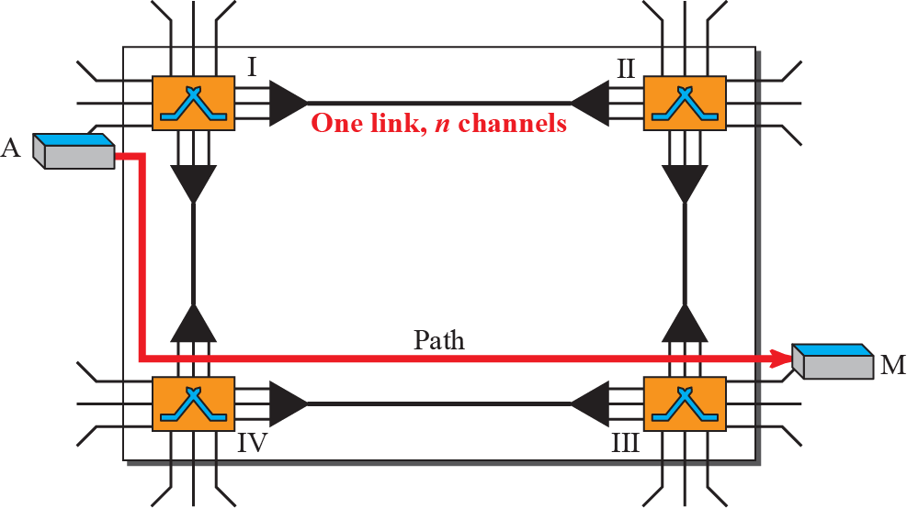
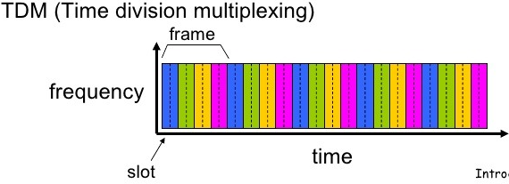
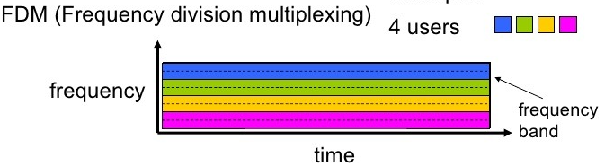
8.2 Circuit Switched network
A simple circuit-switched network
A circuit-switched network is made of a set of switches connected by physical links, in which each link is divided into n channels.

Slide 10
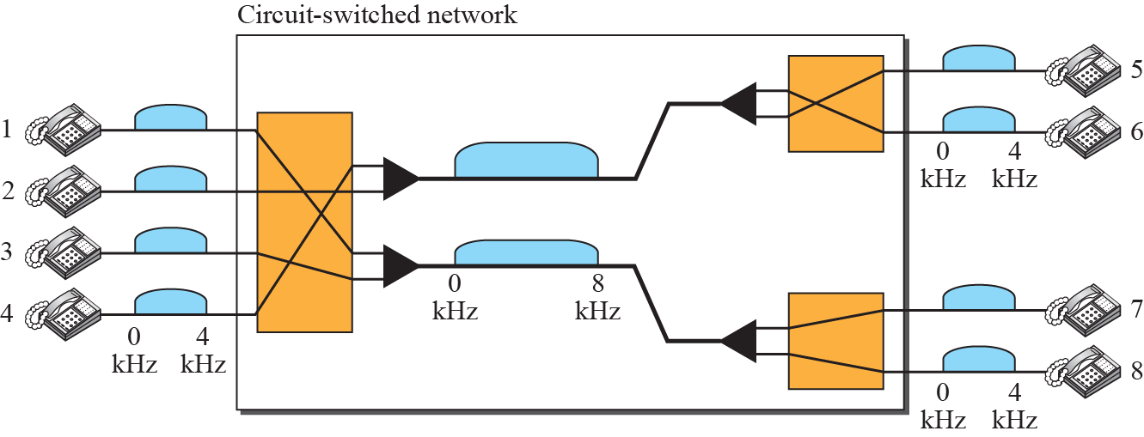
Example 8.1
A circuit-switched network to connect eight telephones.
  Communication is through 4-kHz voice channels.
  We assume that each link uses FDM to connect a maximum of two voice channels. The bandwidth of each link is then 8 kHz.
  Telephone 1 is connected to 7; 2 to 5; 3 to 8; and 4 to 6.
  The switch controls the connections.

Slide 11
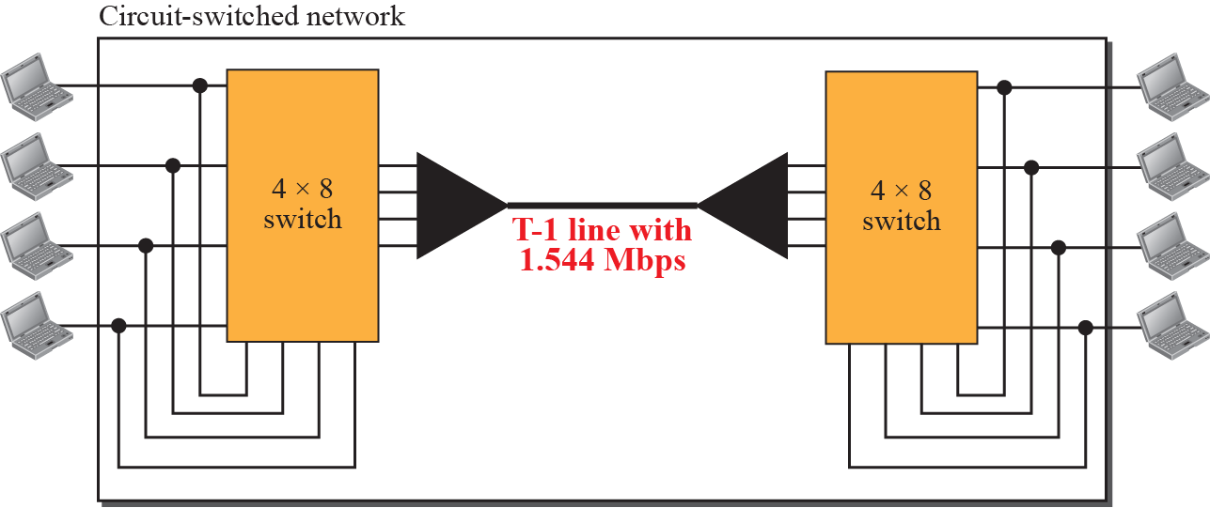
Example 8.2
Connecting computers in two remote offices of a private company.
  The offices are connected using a T-1 line leased from a communication service provider.
  There are two 4 × 8 (4 inputs and 8 outputs) switches in this network.
Switching at the physical layer in the traditional telephone network uses the circuit-switching approach.

Slide 12
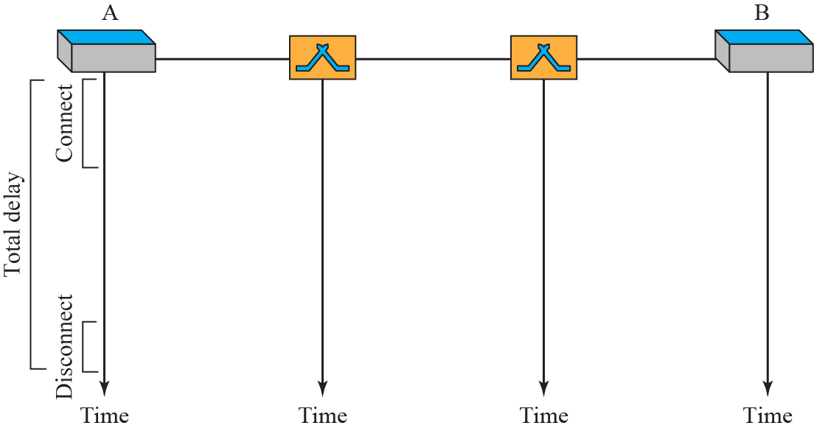
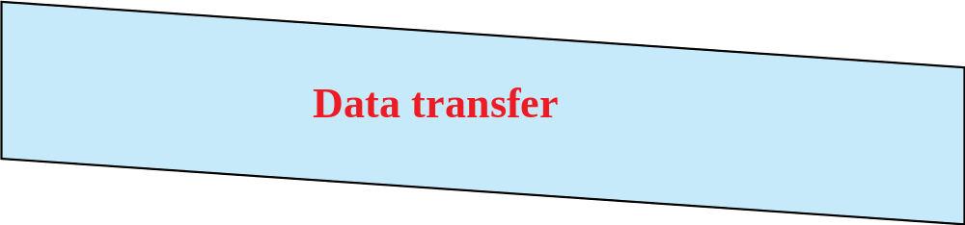
8.2.1 Three Phases
The actual communication in a circuit-switched network requires three phases:
  connection setup
  data transfer
  connection teardown

Slide 13
8.2.2 Efficiency
Circuit-switched networks are not as efficient as the other two types of networks.
  The resources are allocated during the entire duration of the connection.
  These resources are unavailable to other connections.
    In a telephone network, people normally terminate the communication when they have finished their conversation.

Slide 14
8.2.3 Delay
The delay of data transfer in circuit-switched networks of network is minimal.
  During data transfer the data are not delayed at each switch.
  The resources are allocated for the duration of the connection.

Slide 15
8.3 Packet Switched Network
In data communications, a message is sent from one end system to another.
If the message is passed through a packet-switched network, it needs to be divided into packets of fixed or variable size.
  The size of the packet is determined by the network and the governing protocol.
Topics discussed in this section:
8.3.1 Datagram Network
8.3.2 Virtual Circuit Network

Slide 16
8.3 Packet Switched Network
Store-and-Forward
  The information is sent to an intermediate station where it is kept and sent at a later time to the next station.
Two type of Packet-switched network
  Virtual Circuit
  Datagram
In a packet-switched network, there is no resource reservation;
resources are allocated on demand.

Slide 17
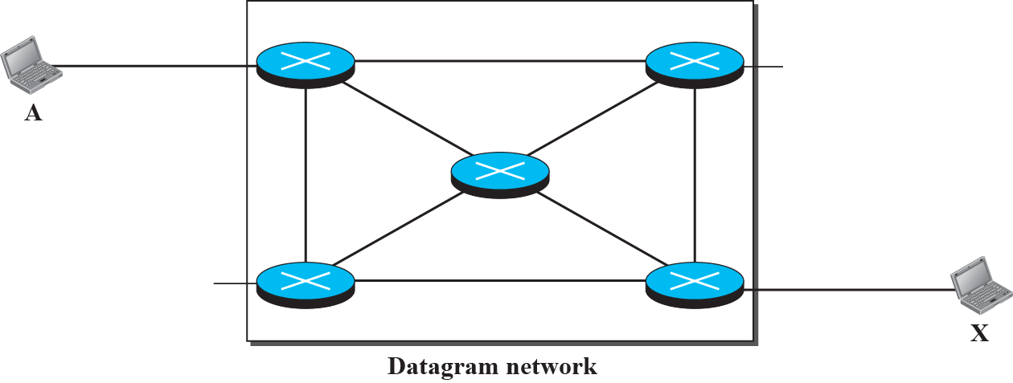






8.3.1 Datagram Network
Datagram Network
  Each packet is treated independently of all others.
  Even if a packet is part of a multipacket transmission, the network treats it as though it existed alone. 순서를 재정리해야
  Connectionless Oriented
A Datagram network with four switches (routers)

Slide 18
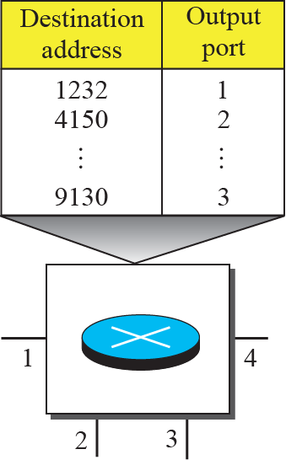
8.3.1 Datagram Network
Routing table in a datagram network
  A switch in a datagram network uses a routing table that is based on the destination address.
  The destination address in the header of a packet in a datagram network remains the same during the entire journey of the packet.

Slide 19
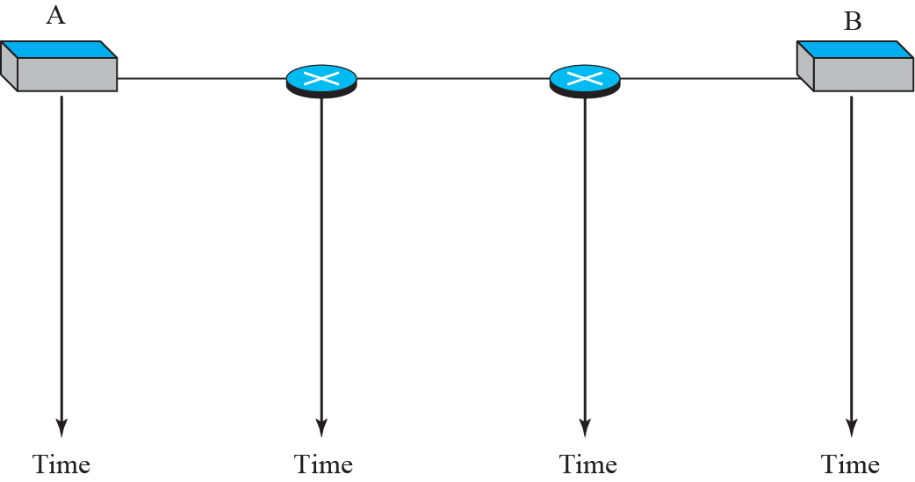



8.3.1 Datagram Network
Delays in a datagram network
  Total delay = 3Τ+ 3τ(propagation time) + W₁ + W₂
  Each packet may wait at a switch before it tis forwarded to find which node is the next.
Τ
τ
W₁
W₂
Switching in the Internet is done by using the datagram approach to packet switching at the network layer

Slide 20
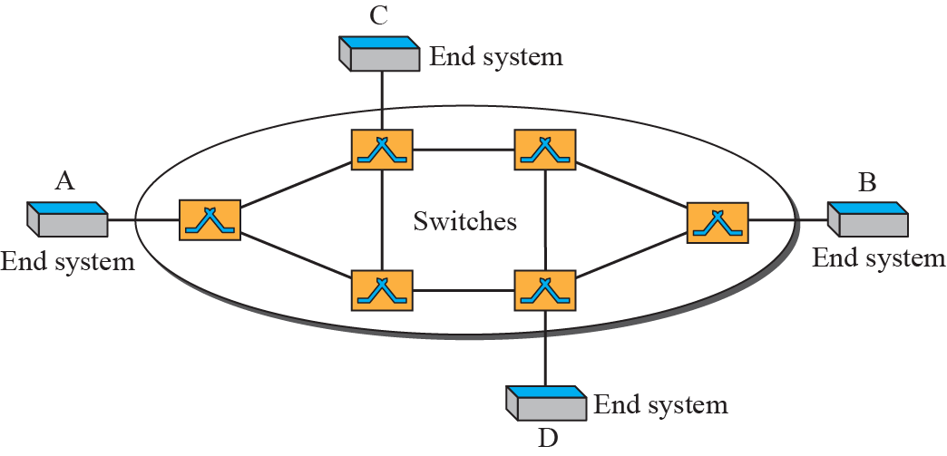
8.3.2 Virtual Circuit Network
A virtual-circuit network is a cross between a circuit-switched network and a datagram network.
  It has some characteristics of both.
  Virtual Circuit is the logical connection between two end systems.
  Connection Oriented

Slide 21
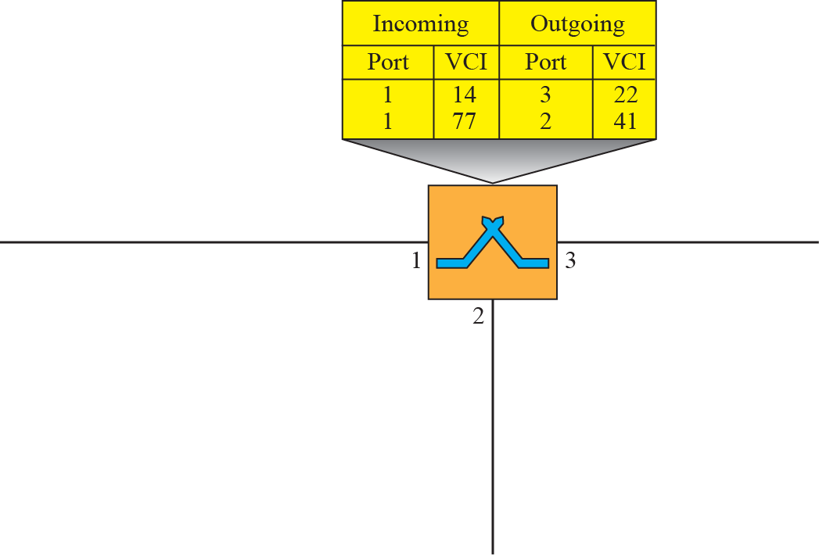



8.3.2 Virtual Circuit Network
  Two types of addressing
  Global address :
    Unique in the Internet, IP Address
  Virtual Circuit Identifier(VCI) :
    a small number used by a frame between two switches.
    When a frame arrives at a switch, it has a VCI; when it leaves, it has different VCI.

Slide 22
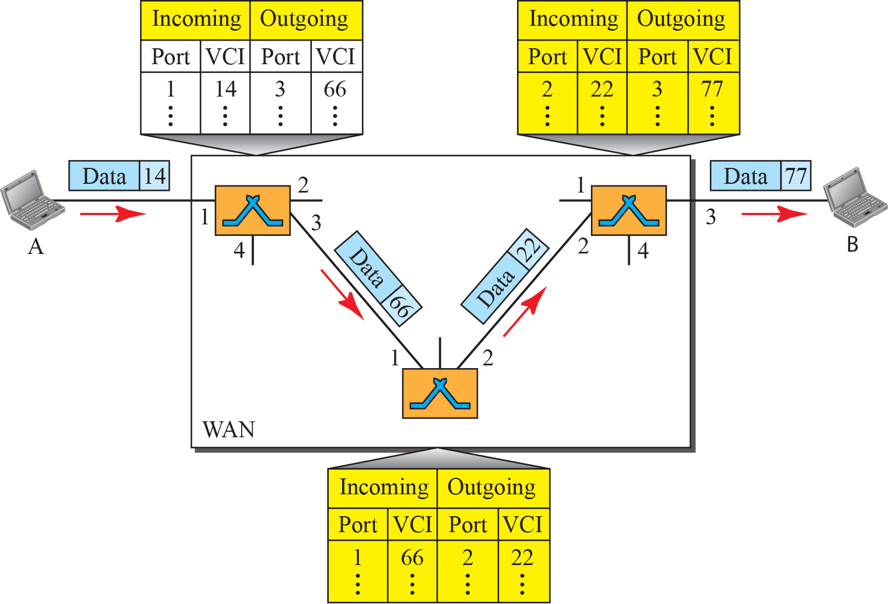
8.3.2 Virtual Circuit Network
Source-to-destination data transfer in a virtual-circuit network

Slide 23
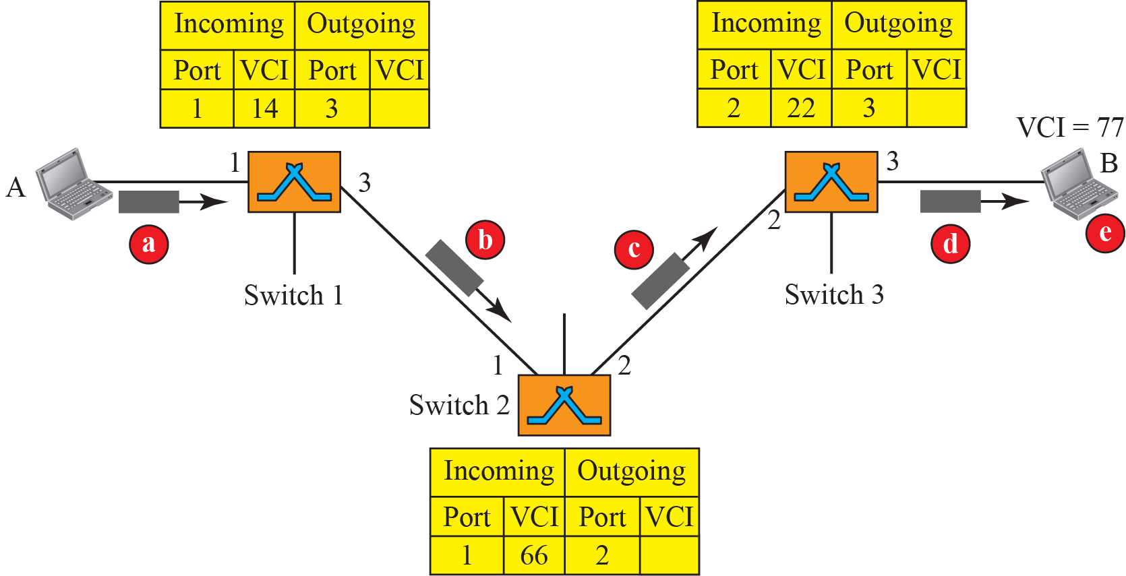
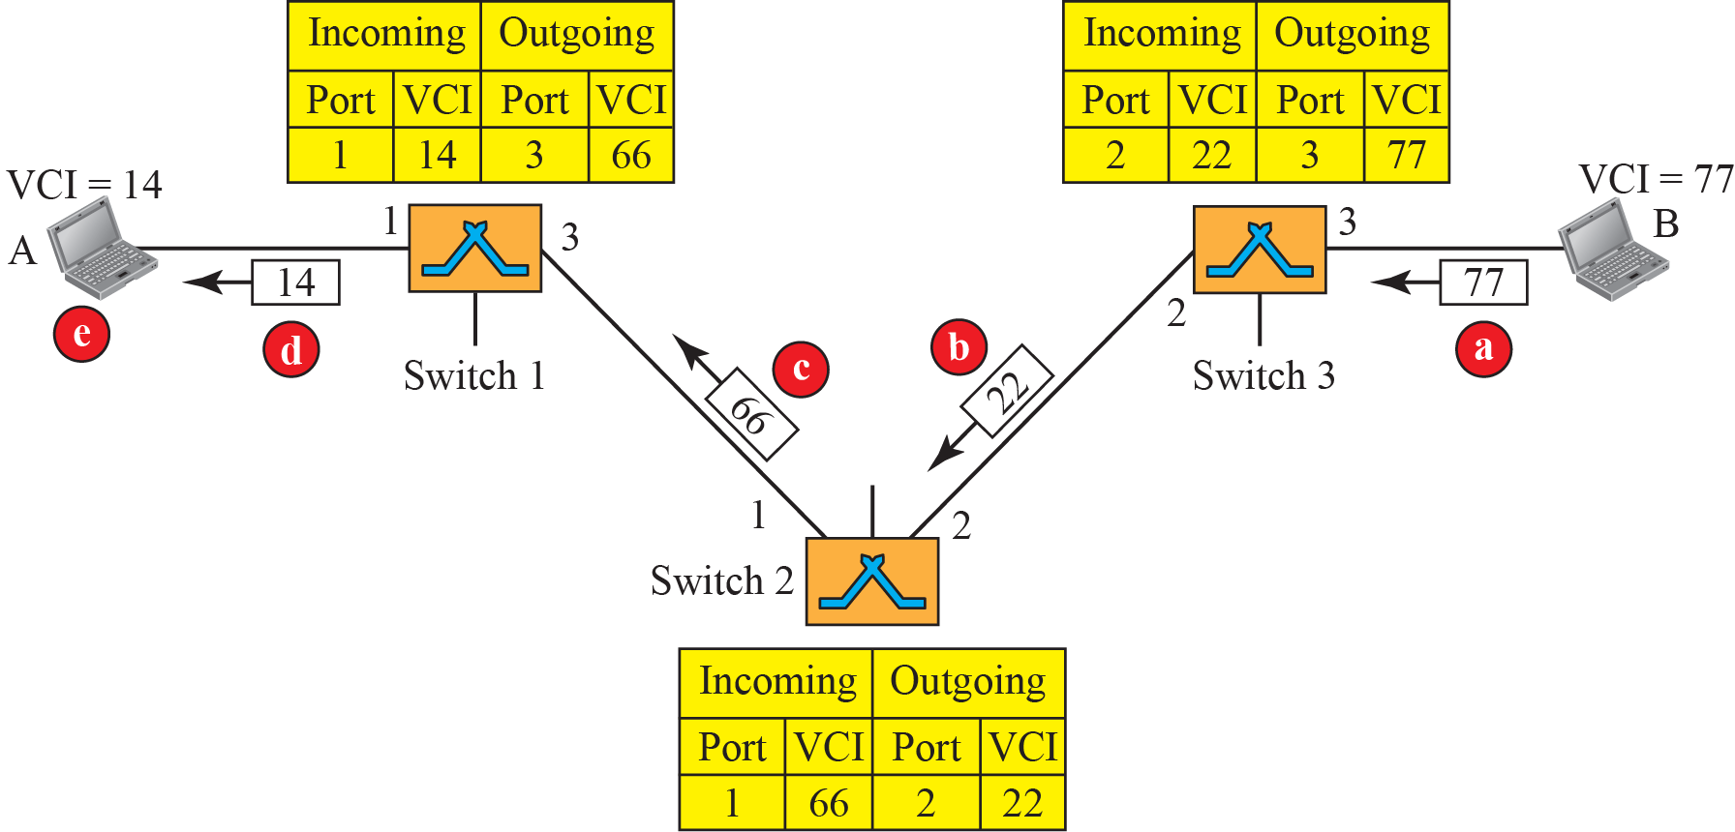
8.3.2 Virtual Circuit Network
Set up request and acknowledgement
Setup request
Setup acknowledgment

Slide 24
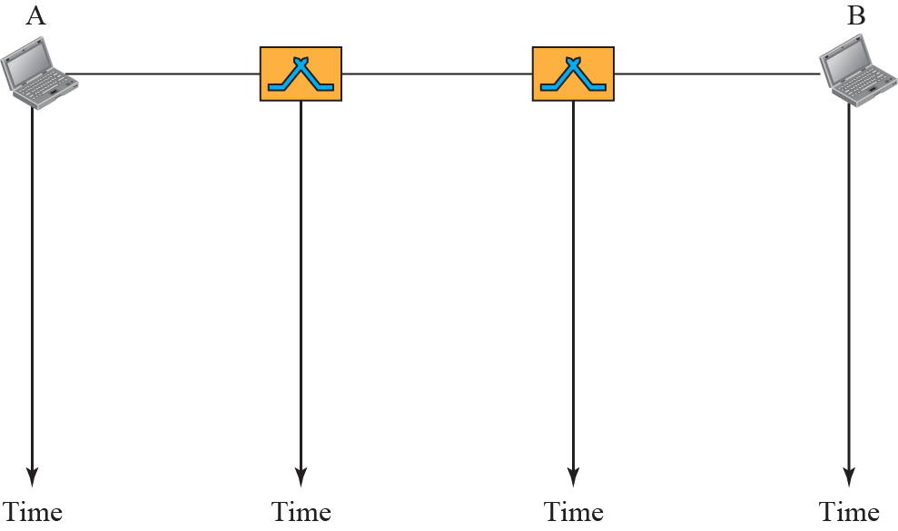


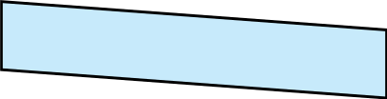

8.3.2 Virtual Circuit Network
Delay in a virtual-circuit network
  Total delay = 3Τ+3τ+ setup delay + teardown delay

Slide 25
8.3.2 Virtual Circuit Network
In virtual-circuit switching, all packets belonging to the same source and destination travel the same path;
but the packets may arrive at the destination with different delays if resource allocation is on demand.

Slide 26
8.4 The Structure of a Switch
We use switches in circuit-switched and packet-switched networks.
In this section, we discuss the structures of the switches used in each type of network.
Topics discussed in this section:
8.4.1 Structure of Circuit Switches
8.4.2 Structure of Packet Switches

Slide 27
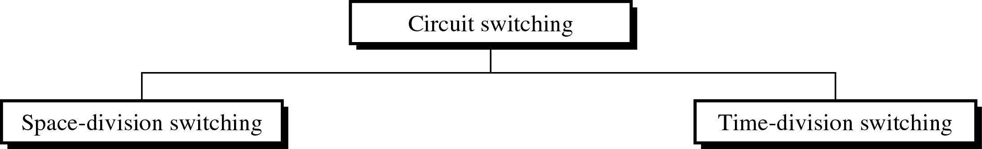
8.4.1 Structure of Circuit Switches
Circuit switching today can use either of two technologies:
Space-Division Switch
  The paths in the circuit are separated from one another spatially.

Slide 28
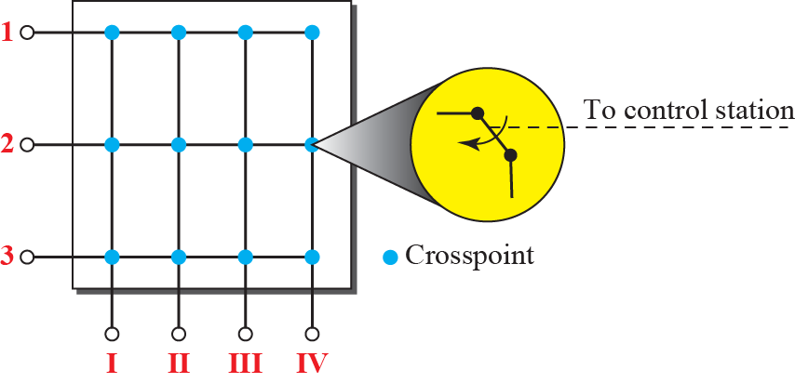
8.4.1 Structure of Circuit Switches
Crossbar switch with three inputs and four outputs

Slide 29
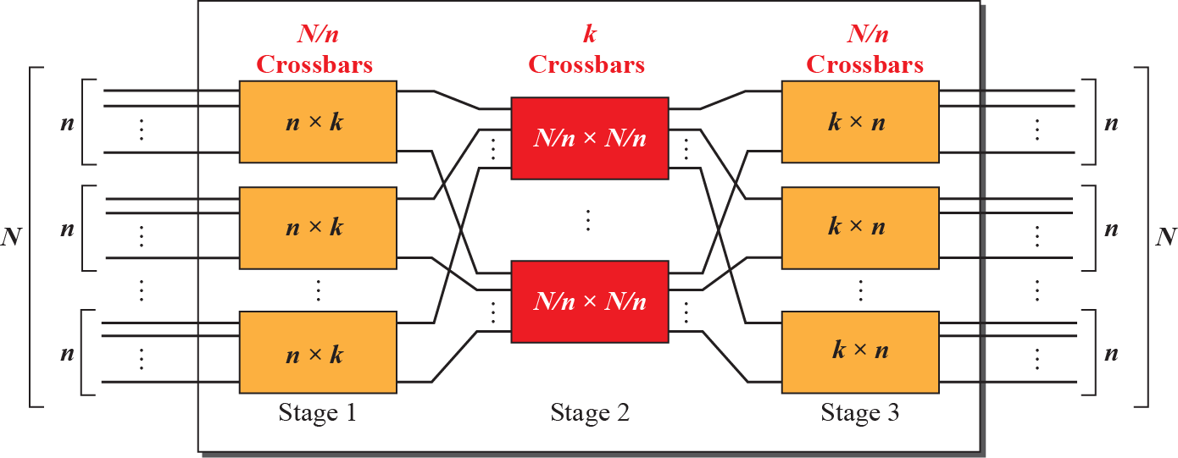
8.4.1 Structure of Circuit Switches
Multistage switch
In a three-stage switch, the total number of crosspoints is 2kN + k(N/n)²
which is much smaller than the number of crosspoints in a single-stage switch (N²).

Slide 30
Example 8.3
Design a three-stage, 200 × 200 switch (N = 200) with k = 4 and n = 20.
Solution
In the first stage we have N/n or 10 crossbars, each of size 20 × 4.
In the second stage, we have 4 crossbars, each of size 10 × 10.
In the third stage, we have 10 crossbars, each of size 4 × 20. The total number of crosspoints is 2kN + k(N/n)², or 2000 crosspoints.
This is 5 percent of the number of crosspoints in a single-stage switch (200 × 200 = 40,000).

Slide 31
Example 8.4
Redesign the previous three-stage, 200 × 200 switch, using the Clos criteria with a minimum number of crosspoints.
Solution
We let n = (200/2)^{1/2}, or n = 10. We calculate k = 2n − 1 = 19. In the first stage, we have 200/10, or 20, crossbars, each with 10 × 19 crosspoints.
In the second stage, we have 19 crossbars, each with 10 × 10 crosspoints.
In the third stage, we have 20 crossbars each with 19 × 10 crosspoints.
The total number of crosspoints is 20(10 × 19) + 19(10 × 10) + 20(19 ×10) = 9500.
According to the Clos criterion: n = (N/2)^{1/2} . k > 2n – 1
Crosspoints ≥ 4N [(2N)^{1/2} – 1]

Slide 32
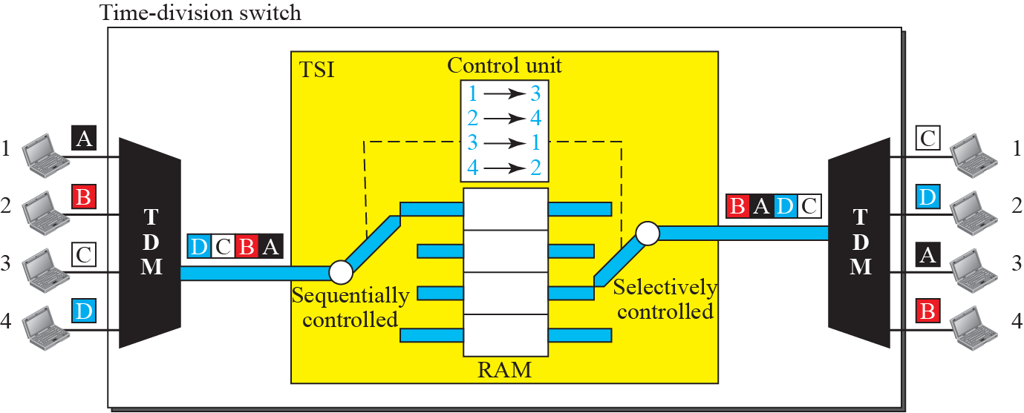
8.4.1 Structure of Circuit Switches
Time Division Switching
  It use TDM(Time-division multiplexing) inside a switch
  The most popular technology is TSI(Time-Slot Interchange)

Slide 33
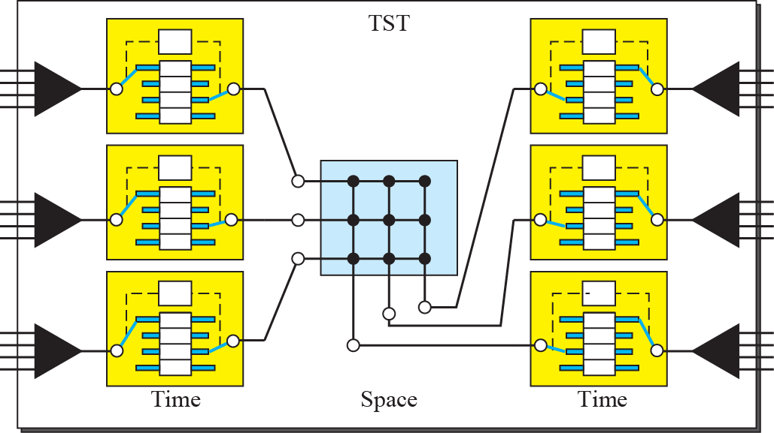
8.4.1 Structure of Circuit Switches
Time-space-time switch

Slide 34
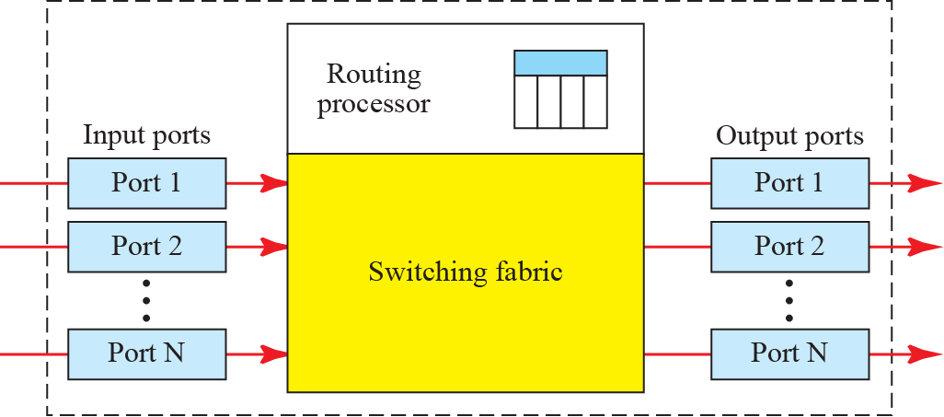
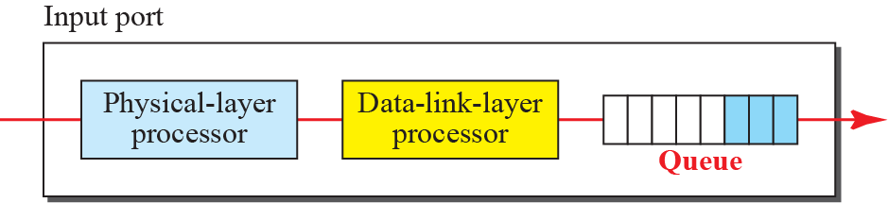
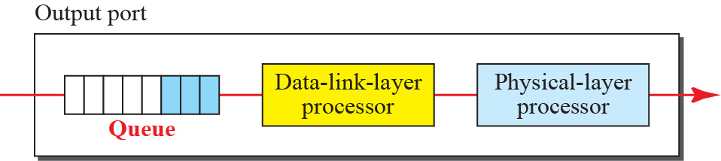
8.4.2 Structure of Packet Switches
Four components of packet switch :
  input ports, output ports,
  the routing processor, and the switching fabric

Slide 35
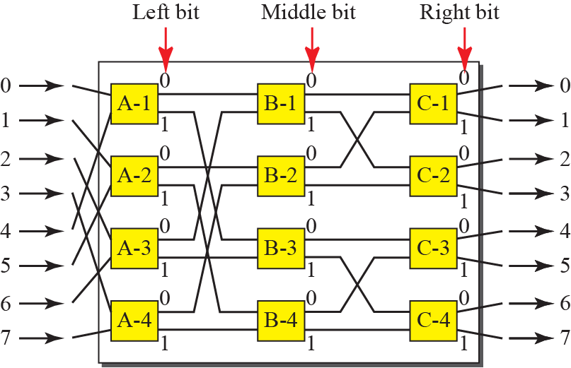
8.4.2 Structure of Packet Switches
A Banyan Switch

Slide 36
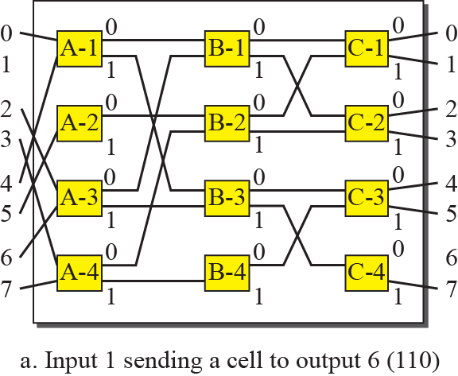
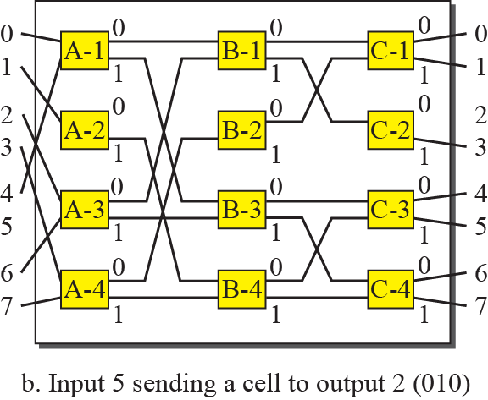


8.4.2 Structure of Packet Switches
Example of routing in a banyan switch

Slide 37
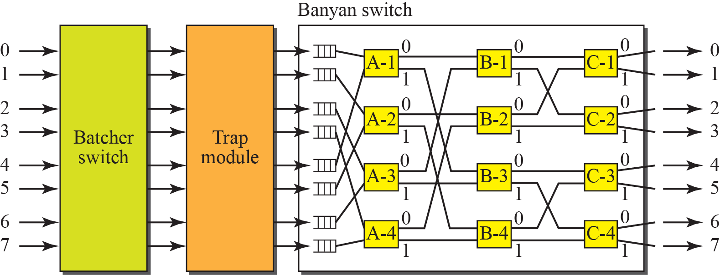
8.4.2 Structure of Packet Switches
Batcher-Banyan Switch

Slide 38

8.5 Summary
Today’s network can be divided into three categories.
  In circuit switching, the resources are dedicated for the entire duration of the setup, data transfer, and teardown phase.
  In packet switching, there is no resource allocation for a packet. (no reserved bandwidth on the link)
  Packet switched network is divided into two subcategories : virtual circuit network and datagram network.

